Slide 1
Analog-to-Digital Converter (ADC)

Slide 2
Outline
SampleCode Projects to cover:
ADC_VR1
ADC_8ch
2

Slide 3
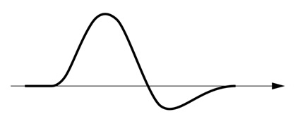
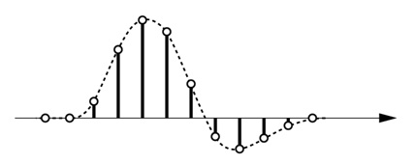
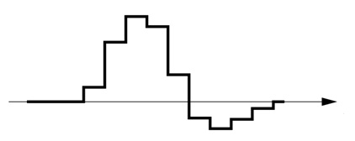
Signal Conversion
ADC
DAC
Filter
3

Slide 4
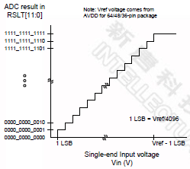
Analog to Digital Conversion
Vin is input voltage for ADC to sample
Vref is reference voltage for ADC to compare with Vin
Vref is connected to 3.3V on NUC140 learning board
12-bit ADC : output is a 12-bit binary code, so its value = 0 ~ 4095
Decimal | Binary | Voltage (Vref=3.3V)
0 | 0000_0000_0000 | 0/4096 * 3.3V
1 | 0000_0000_0001 | 1/4096 * 3.3V
2048 | 1000_0000_0000 | 2048/4096 * 3.3V
4095 | 1111_1111_1111 | 4095/4096 * 3.3V
4

Slide 5
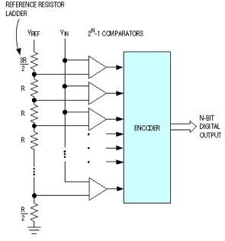
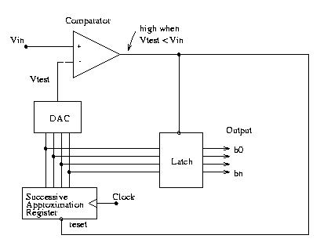
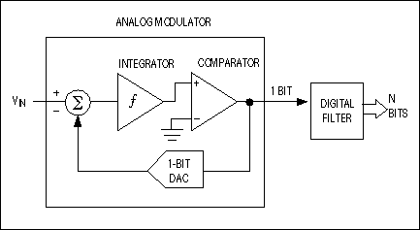
ADC Architectures
Direct-Conversion ADC
SAR (Successive Approximation Register) ADC
ΔΣ (Sigma-Delta) ADC
Sigma-Delta ADC
SAR ADC
Successive Approximation Register
Direct-Conversion ADC
5

Slide 6
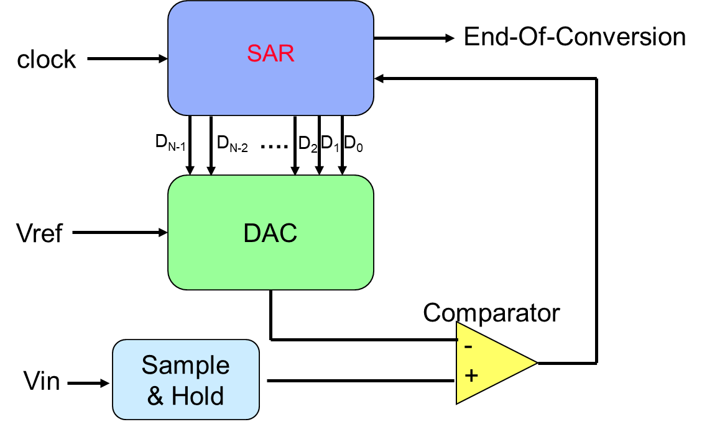
SAR (Successive Approximation Register) ADC
這一種ADC由一個DAC與電壓比較器組成，依序由MSB往LSB更改DAC的輸出電壓。
流程：
由MSB開始
啟動DAC的第n bit (D_{N-1})
將輸入的訊號與DAC的輸出做比較，若輸入訊號較大，則設定ADC輸出的第n bit為HIGH，並保留DAC上面的設定，反之若較小，清除DAC的第n bit，並設定ADC輸出的第n bit為LOW
由這一個狀態迭代至LSB(D₀)為止
6

Slide 7
NUC140 ADC
Overview
Contain one 12-bit successive approximation analog-to-digital converters (SAR A/D converter) with 8 input channels.
The A/D converter supports three operation modes: single, single-cycle scan and continuous scan mode.
Features
Analog input voltage range: 0~Vref (Max to 5.0V).
12-bit resolution and 10-bit accuracy is guaranteed
Input channel:
Up to 8 single-end analog input channels
4 pairs of differential analog input channel
The maximum ADC operating frequency is 16M Hz
Three ADC operation modes
Single mode
Single-cycle mode
Continuous mode
An A/D conversion can be started by
Software write 1 to ADST bit
External pin STADC
7

Slide 8
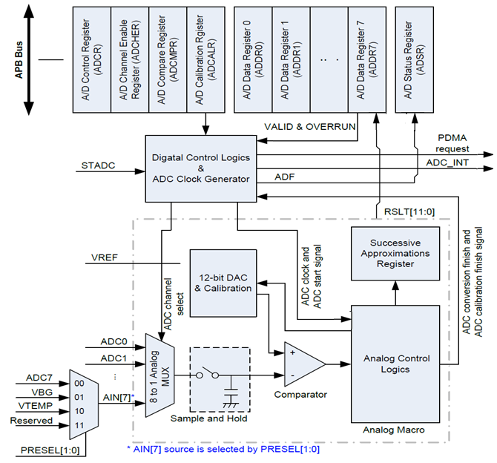
NUC140 ADC Block Diagram
8

Slide 9
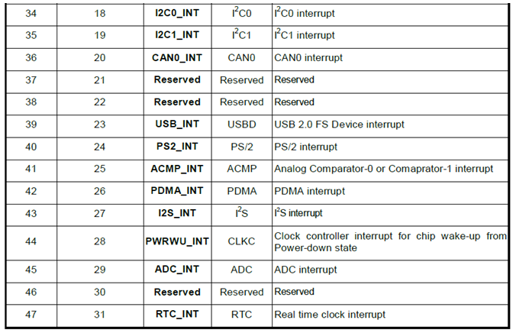
NUC140 System Interrupt Map
9

Slide 10
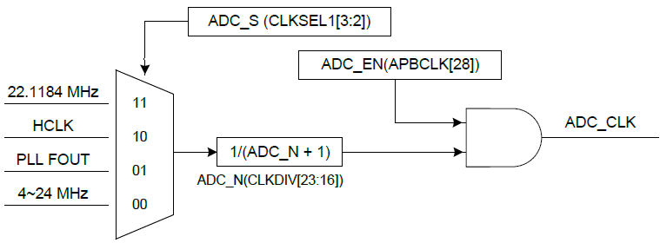
ADC Clock Source
The maximum sampling rate is up to 700K SPS (Samples Per Second)
The ADC engine has four clock sources selected by 2-bit ADC_S (CLKSEL1[3:2]).
ADC clock frequency is divided by an 8-bit prescaler with the formula:
The ADC clock frequency = (ADC clock source frequency) / (ADC_N+1);
,where the 8-bit ADC_N is located in register CLKDIV[23:16].
10

Slide 11
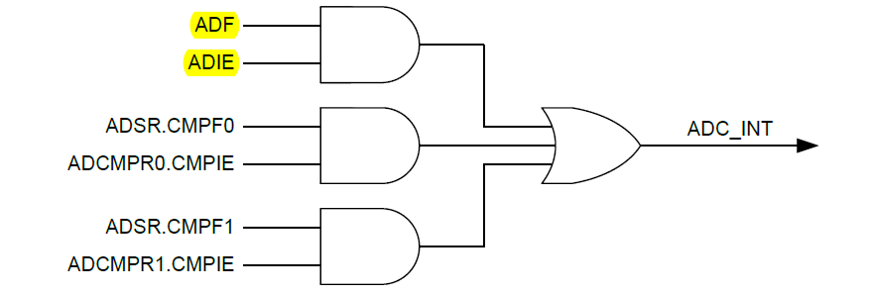
ADC Interrupt Sources
There are three interrupt sources of ADC interrupt
When an ADC operation mode finishes its conversion, the A/D conversion end flag, ADF, will be set to 1
When one of the flags, ADF, CMPF0 and CMPF1, is set to 1 and the corresponding interrupt enable bit, ADIE of ADCR and CMPIE of ADCMPR0/1, is set to 1, the ADC interrupt will be asserted
11

Slide 12
Functional Description
Single Mode
A/D conversion is performed only once on the specified single channel
The operations are as follows:
A/D conversion will be started when the ADST bit of ADCR is set to 1 by software or external trigger input.
When A/D conversion is finished, the result is stored in the A/D data register corresponding to the channel. The ADF bit of ADSR register will be set to 1.
If the ADIE bit of ADCR register is set to 1, the ADC interrupt will be asserted.
The ADST bit remains 1 during A/D conversion. When A/D conversion ends, the ADST bit is automatically cleared to 0 and the A/D converter enters idle state.
Note: If software enables more than one channel in single mode, the channel with the lowest number will be selected and the other enabled channels will be ignored.
12

Slide 13
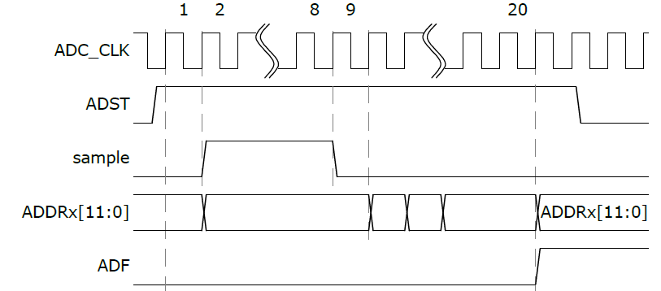
Single Mode Conversion Timing Diagram
13

Slide 14
Functional Description
Single-Cycle Scan Mode
A/D conversion will sample and convert the specified channels once in the sequence from the lowest number enabled channel to the highest number enabled channel.
The operations are as follows:
When the ADST bit of ADCR is set to 1 by software or external trigger input, A/D conversion starts on the channel with the lowest number.
When A/D conversion for each enabled channel is completed, the result is sequentially transferred to the A/D data register corresponding to each channel.
When the conversions of all the enabled channels are completed, the ADF bit in ADSR is set to 1.
If the ADC interrupt function is enabled, the ADC interrupt occurs.
After A/D conversion ends, the ADST bit is automatically cleared to 0 and the A/D converter enters idle state
14

Slide 15
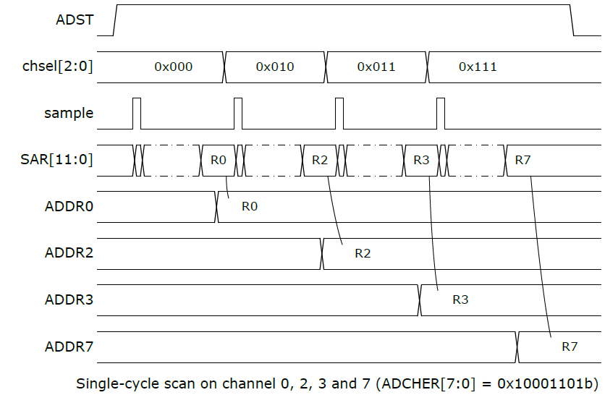
Single-Cycle Scan Mode Conversion Timing Diagram
An example timing diagram for single-cycle scan on enabled channels (0, 2, 3 and 7)
15

Slide 16
Functional Description
Continuous Scan Mode
A/D conversion is performed sequentially on the specified channels that enabled by CHEN bits in ADCHER register (maximum 8 channels for ADC)..
The operations are as follows:
When the ADST bit of ADCR is set to 1 by software or external trigger input, A/D conversion starts on the channel with the lowest number.
When A/D conversion for each enabled channel is completed, the result is sequentially transferred to the A/D data register corresponding to each channel.
When the conversions of all the enabled channels are completed, the ADF bit in ADSR is set to 1.
If the ADC interrupt function is enabled, the ADC interrupt occurs. The conversion of the enabled channel with the lowest number will start again if software has not cleared the ADST bit.
As long as the ADST bit remains at 1, the above steps will be repeated.
16

Slide 17
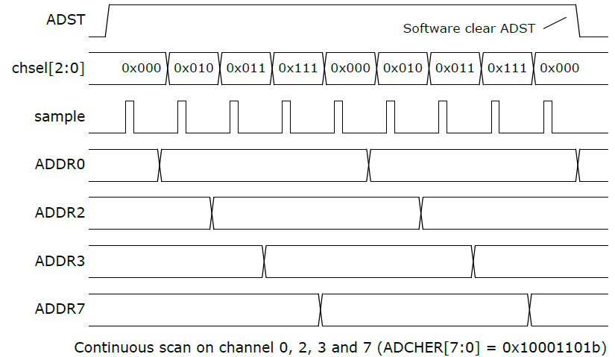
Continuous Scan Mode Conversion Timing Diagram
An example timing diagram for continuous scan on enabled channels (0, 2, 3 and 7)
17

Slide 18
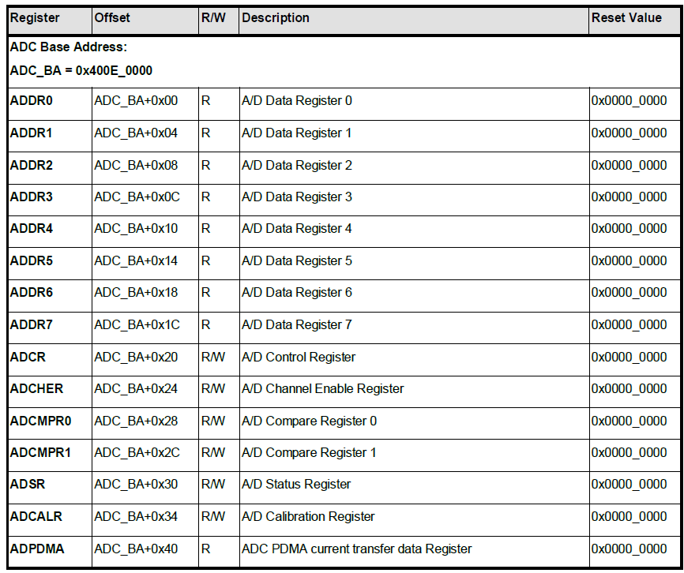
Timer Register Map
18

Slide 19
NUC140 ADC Clock Selection (in SYS_init.c)
void CLK_SetModuleClock(
uint32_t u32ModuleIdx,
uint32_t u32ClkSrc,
uint32_t u32ClkDiv)
ADC Clock Source
CLK_CLKSEL1_ADC_S_HXT
CLK_CLKSEL1_ADC_S_PLL
CLK_CLKSEL1_ADC_S_HCLK
CLK_CLKSEL1_ADC_S_HIRC
ADC Clock Divider
CLK_CLKDIV_ADC(x)
Module Index = ADC
Clock Source
Clock Divider
ADC clock 8-bit divider = x
19

Slide 20
ADC Initialization (in adc.c)
ADC struct pointer
void ADC_Open(ADC_T *adc,
uint32_t u32InputMode,
uint32_t u32OpMode,
uint32_t u32ChMask)
ADC input mode
ADC_INPUT_MODE_SINGLE_END
ADC_INPUT_MODE_DIFFERENTIAL
ADC operation mode
ADC_OPERATION_MODE_SINGLE
ADC_OPERATION_MODE_SINGLE_CYCLE
ADC_OPERATION_MODE_CONTINUOUS
ADC input mode
ADC operation mode
ADC channel
20

Slide 21
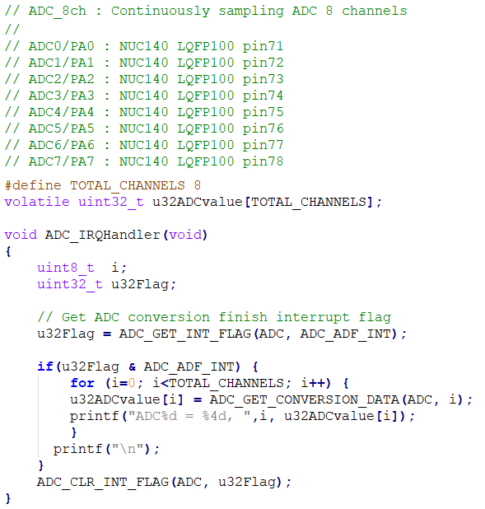
SampleCode: ADC_8ch (Continuous Scan Mode)
check ADC interrupt flag
read ADC value
clear ADC interrupt flag
21

Slide 22
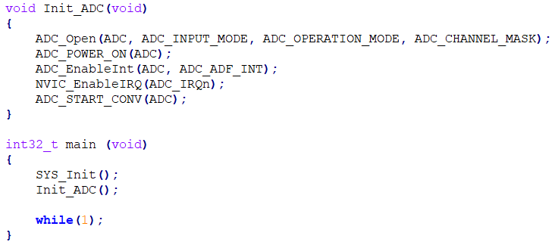
SampleCode: ADC_8ch (Continuous Scan Mode)
SINGLE_END
CONTINUOUS
ADC_CH_0_MASK| … | ADC_CH_7_MASK
22

Slide 23
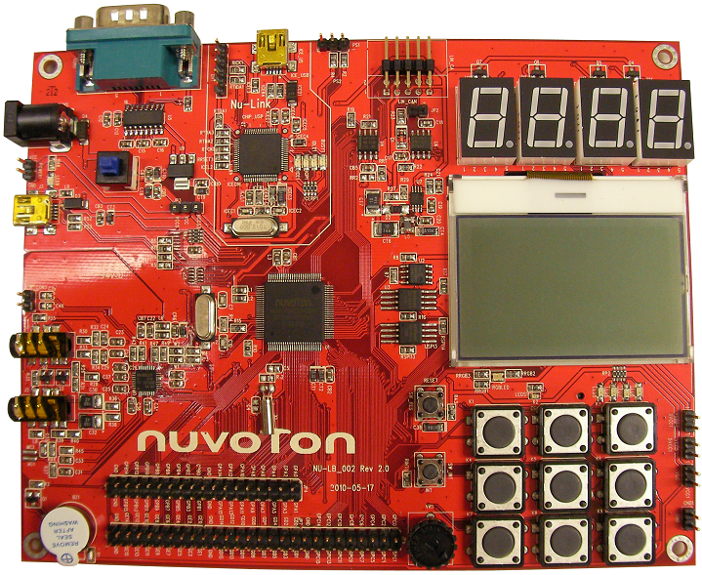
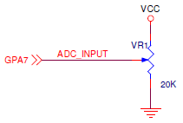
Learning Board
The ADC input pins share with GPIO group A
The ADC input pins must be configured in input type
Learning Board
ADC reference voltage is VCC33 (3.3V)
ADC0~7(GPA0~7)
VR1
23

Slide 24
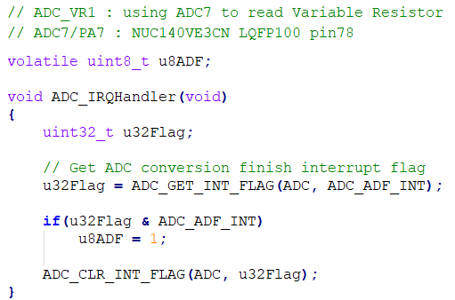
SampleCode: ADC_VR1 (Single-Cycle Scan Mode)
ADC Flag for main loop to detect when ADC sample finished
and ADC interrupt is generated
Set ADC software flag when IRQ ocurrs
24

Slide 25
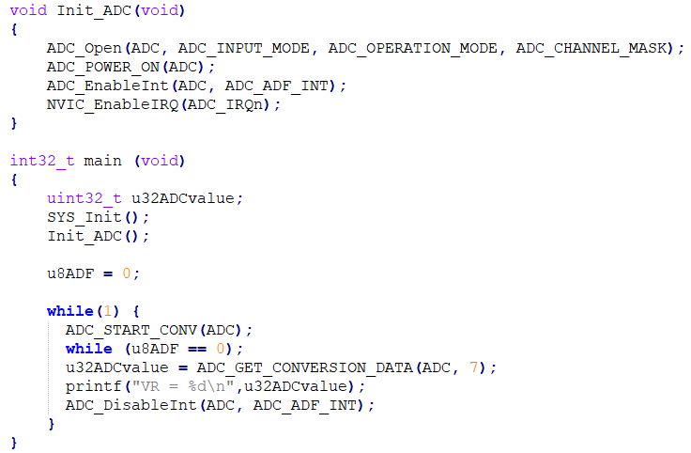
SampleCode: ADC_VR1
SINGLE_END
SINGLE_CYCLE
ADC_CH_7_MASK
start ADC conversion
wait for ADC sampling finished & generate interrupt to set this flag to 1
25

Slide 26
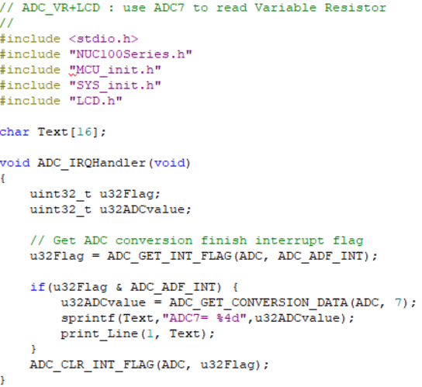
SampleCode: ADC_VR1+LCD
Modify from ADC_Photoresistor
Add LCD.h
26

Slide 27
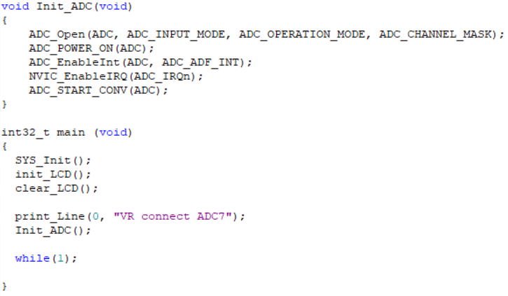
SampleCode: ADC_VR1+LCD
define in MCU_init.h
27

Slide 28
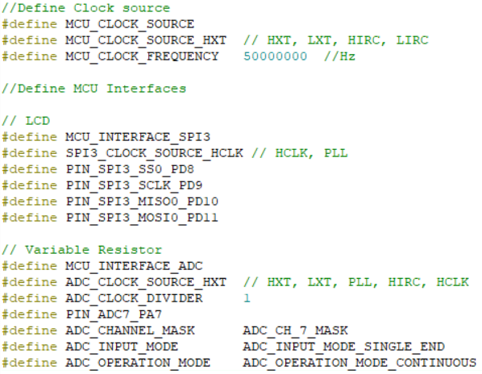
SampleCode: ADC_VR1+LCD (MCU_init.h)
28

Slide 29
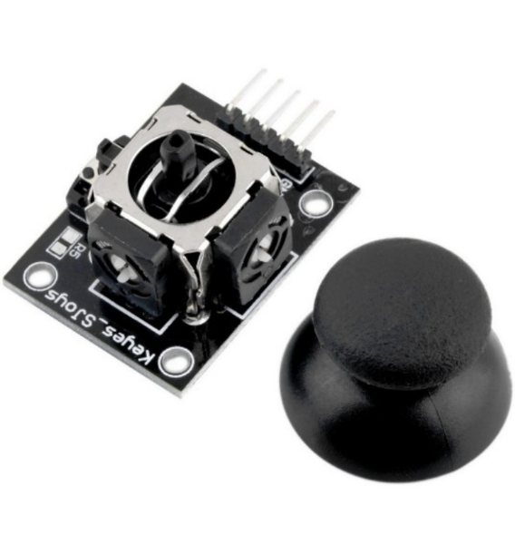
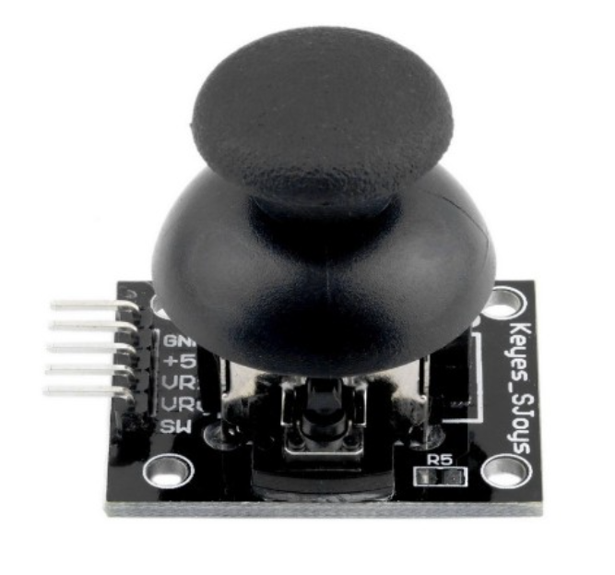
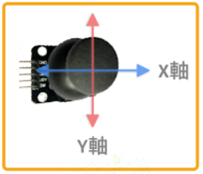
Joystick
Joystick 搖桿為一個雙向的10K電阻器，隨著搖桿方向不同，電阻值會隨著改變。
搖桿使用5V供電時，原始狀態下X,Y讀出的電壓為2.5V 。
向下按搖杆，可以觸動一個開關，對外輸出 0 或 1 的數位訊號。
29

Slide 30
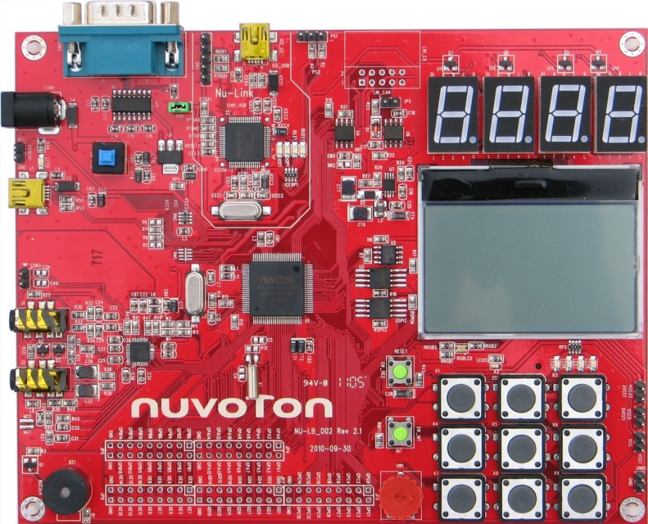
ADC_Joystick
VRx : PA0
VRy : PA1
SW : PC0
30

Slide 31
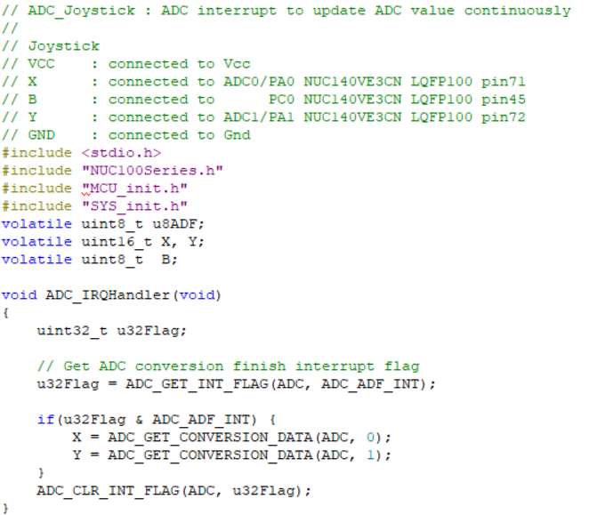
ADC_Joystick
31

Slide 32
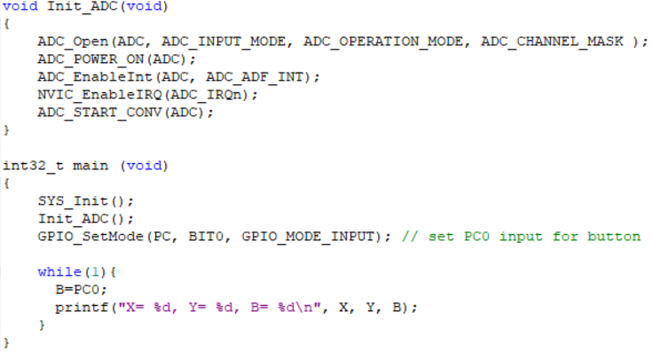
ADC_Joystick
define in MCU_init.h
32

Slide 33
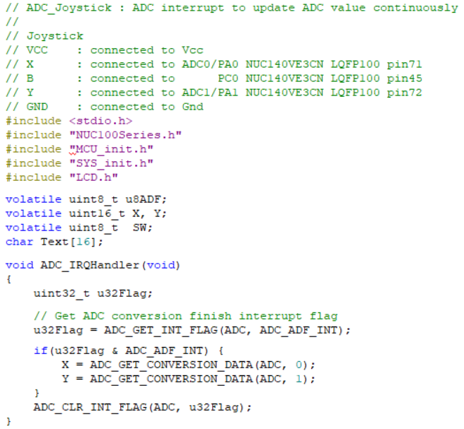
ADC_Joystick+LCD
Add LCD.h
33

Slide 34
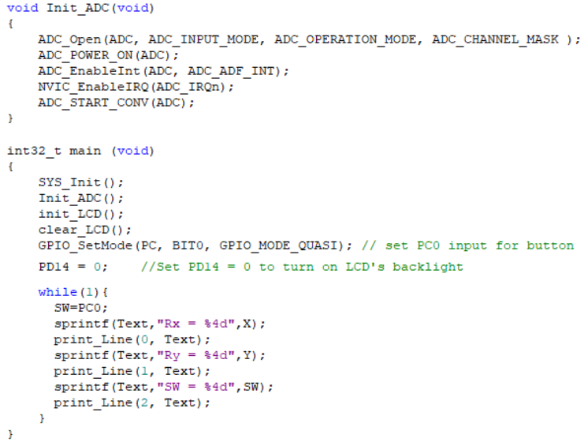
ADC_Joystick+LCD
In this case, QUASI mode is more stable than INPUT mode
34

Slide 35
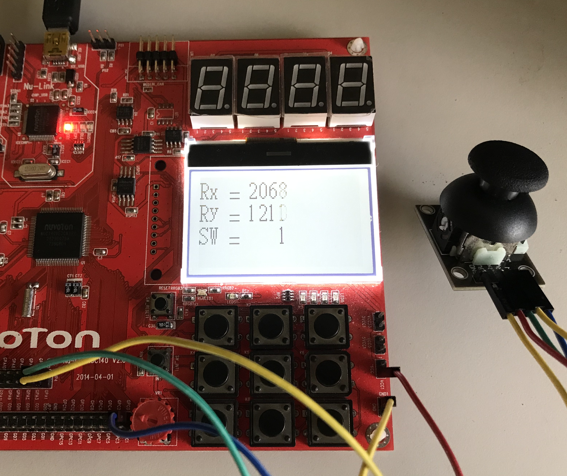
ADC_Joystick+LCD
35

